Slide 1
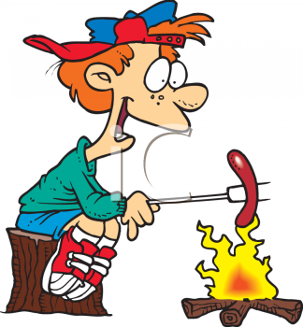
Energy is transferred to the sausage from the fire by natural convection – hot air is less dense than surrounding air and rises
hot air rises

Slide 2
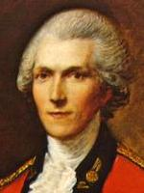
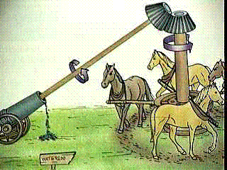
The conclusion was that heat was inexhaustible as long as the horses kept working and the drill bit was boring, heat continued being generated
conversation of energy

Slide 3
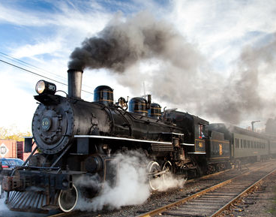
Thermodynamic System

Slide 4
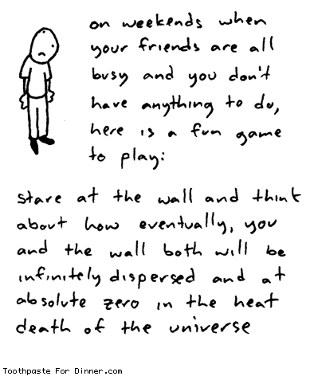


Slide 5
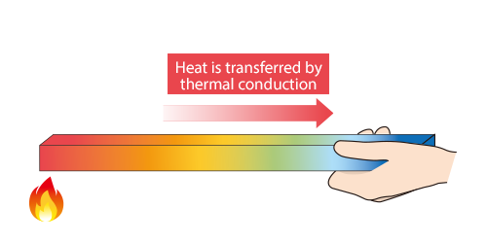
HEAT Q: energy transferred spontaneously from the higher temperature region to the lower temperature region
hot
cold

Slide 6



Slide 7
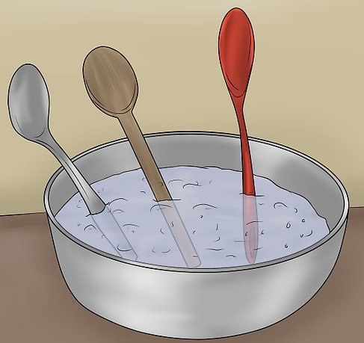

Slide 8
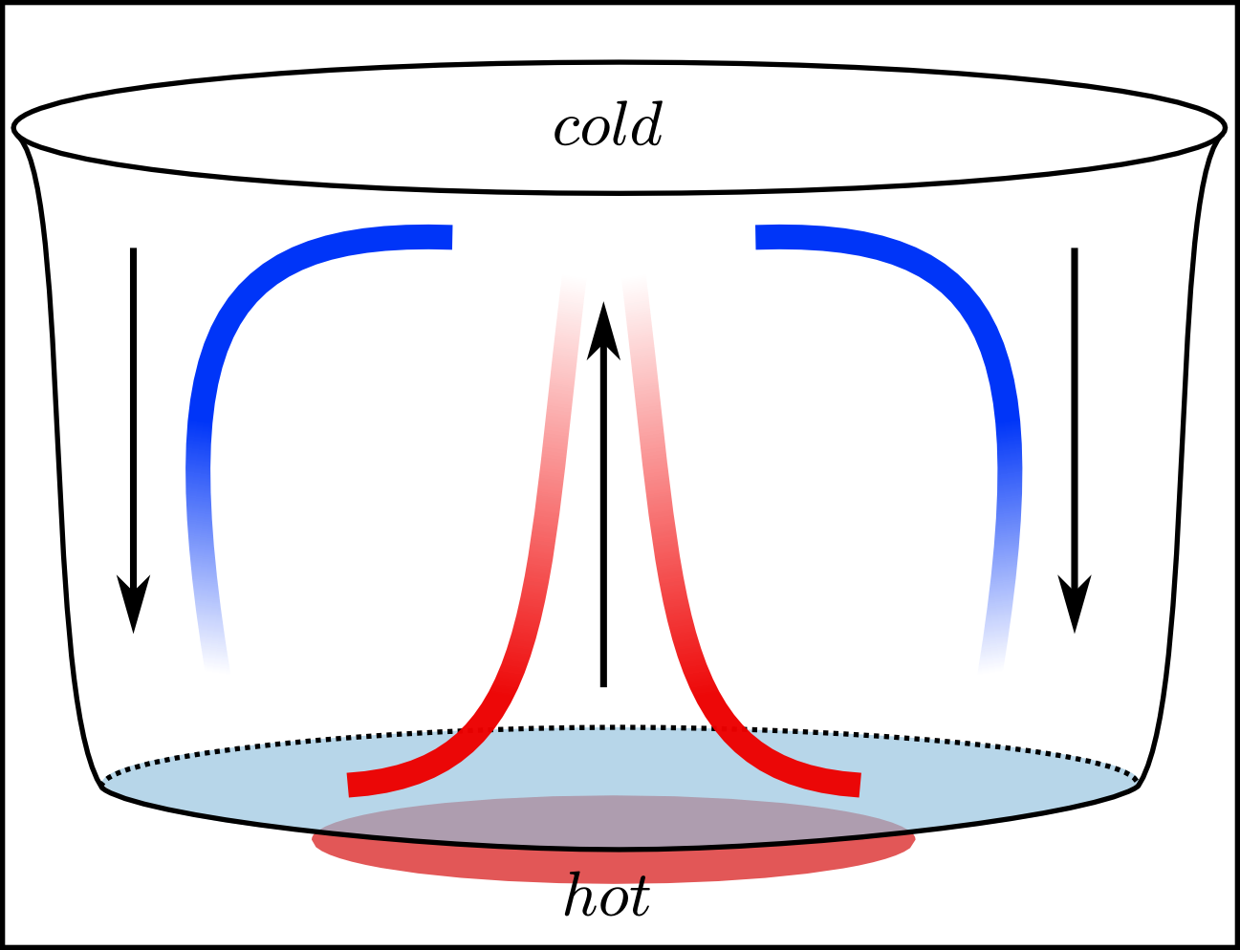
air above the saucepan is heated and rises by convection
cold
cool more dense water sinks
hot
hot less dense water rises
convection currents setup by the movement of the higher energy particles replacing the lower energy particles. In convection the particles can move over large distances.

Slide 9
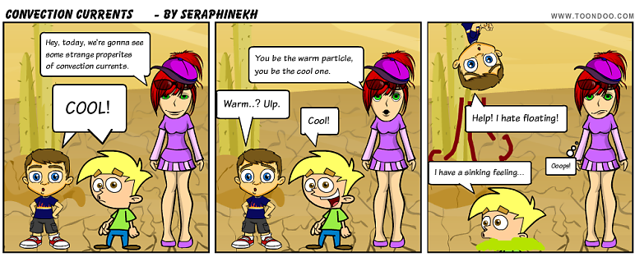

Slide 10
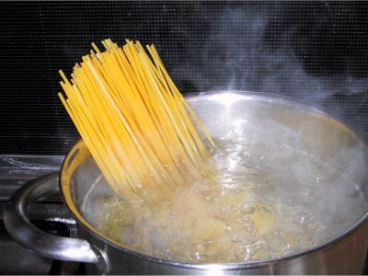
hot steam rising due to
convection
vigorous water movement due to convection currents
Boiling water moves around rapidly because of convection currents

Slide 11
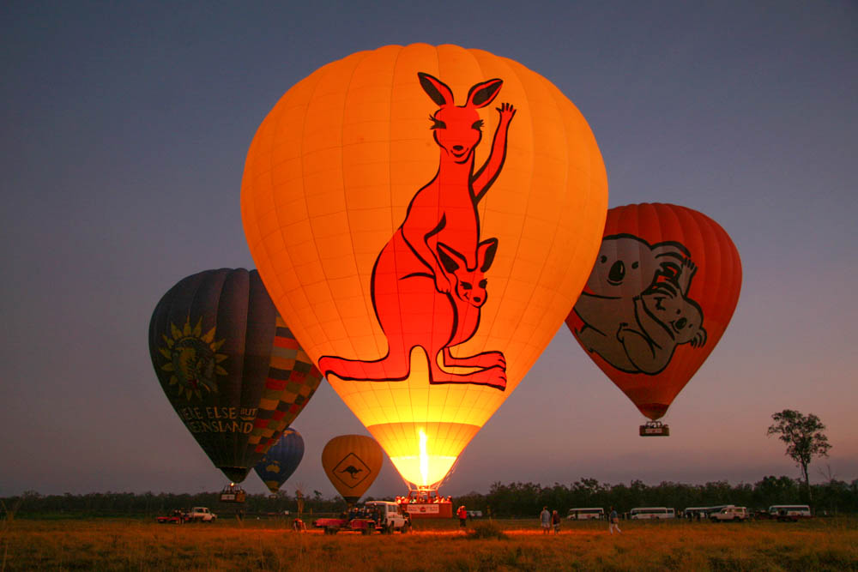

Slide 12
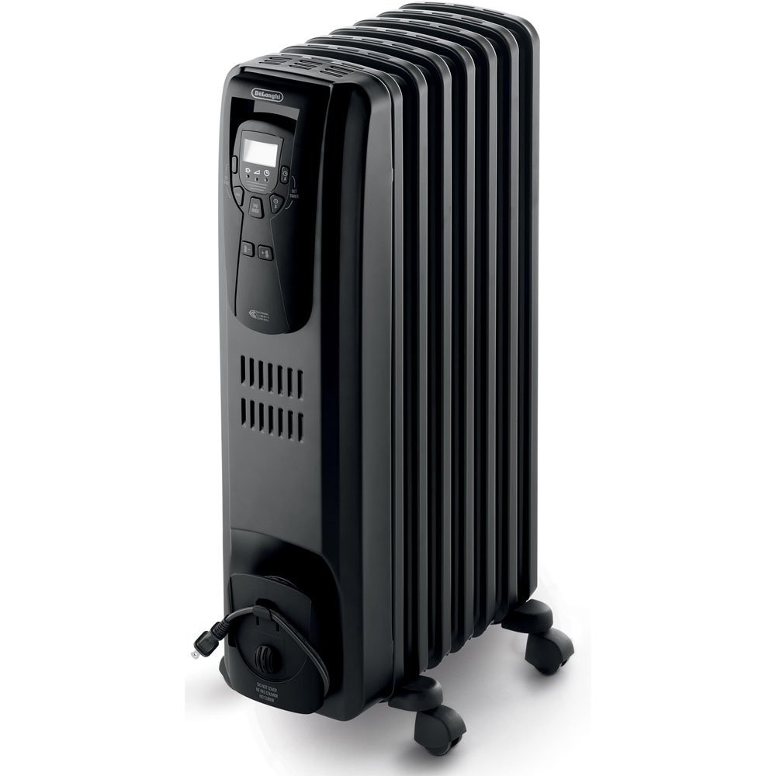
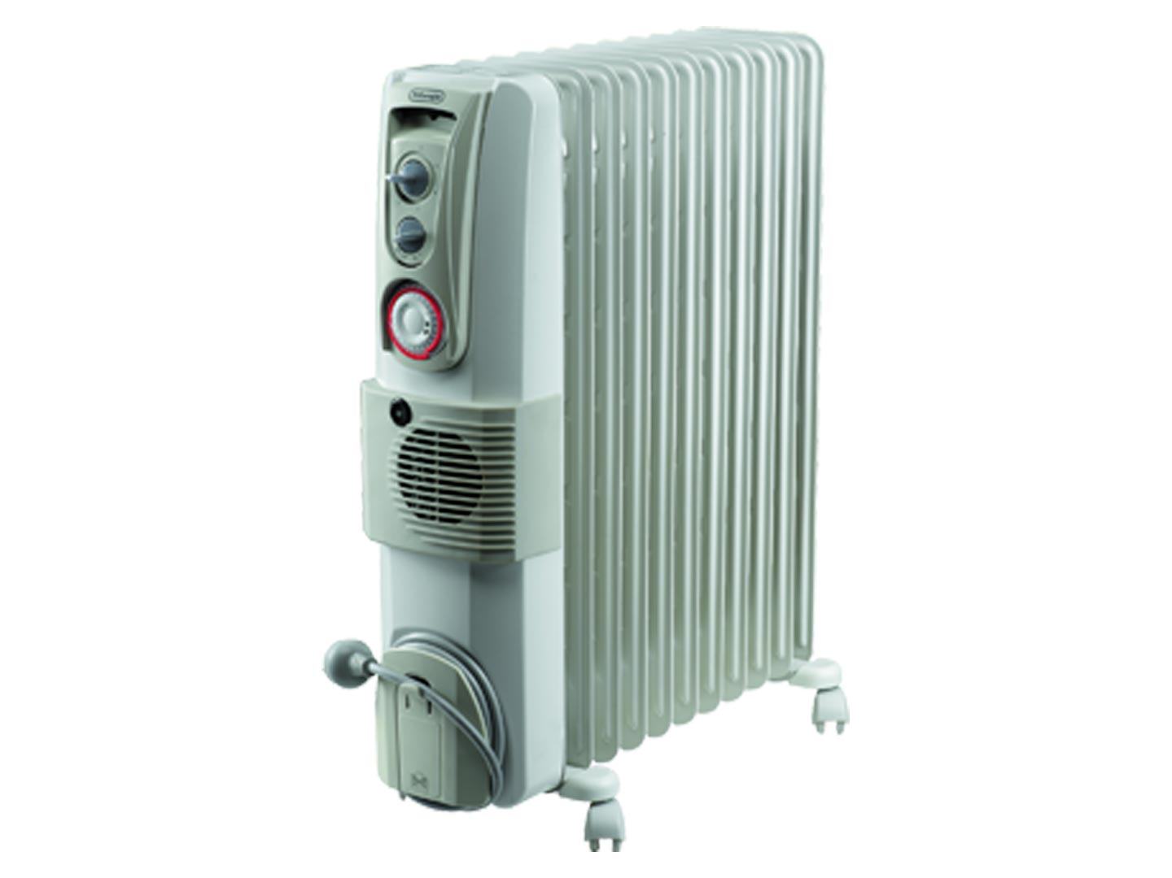
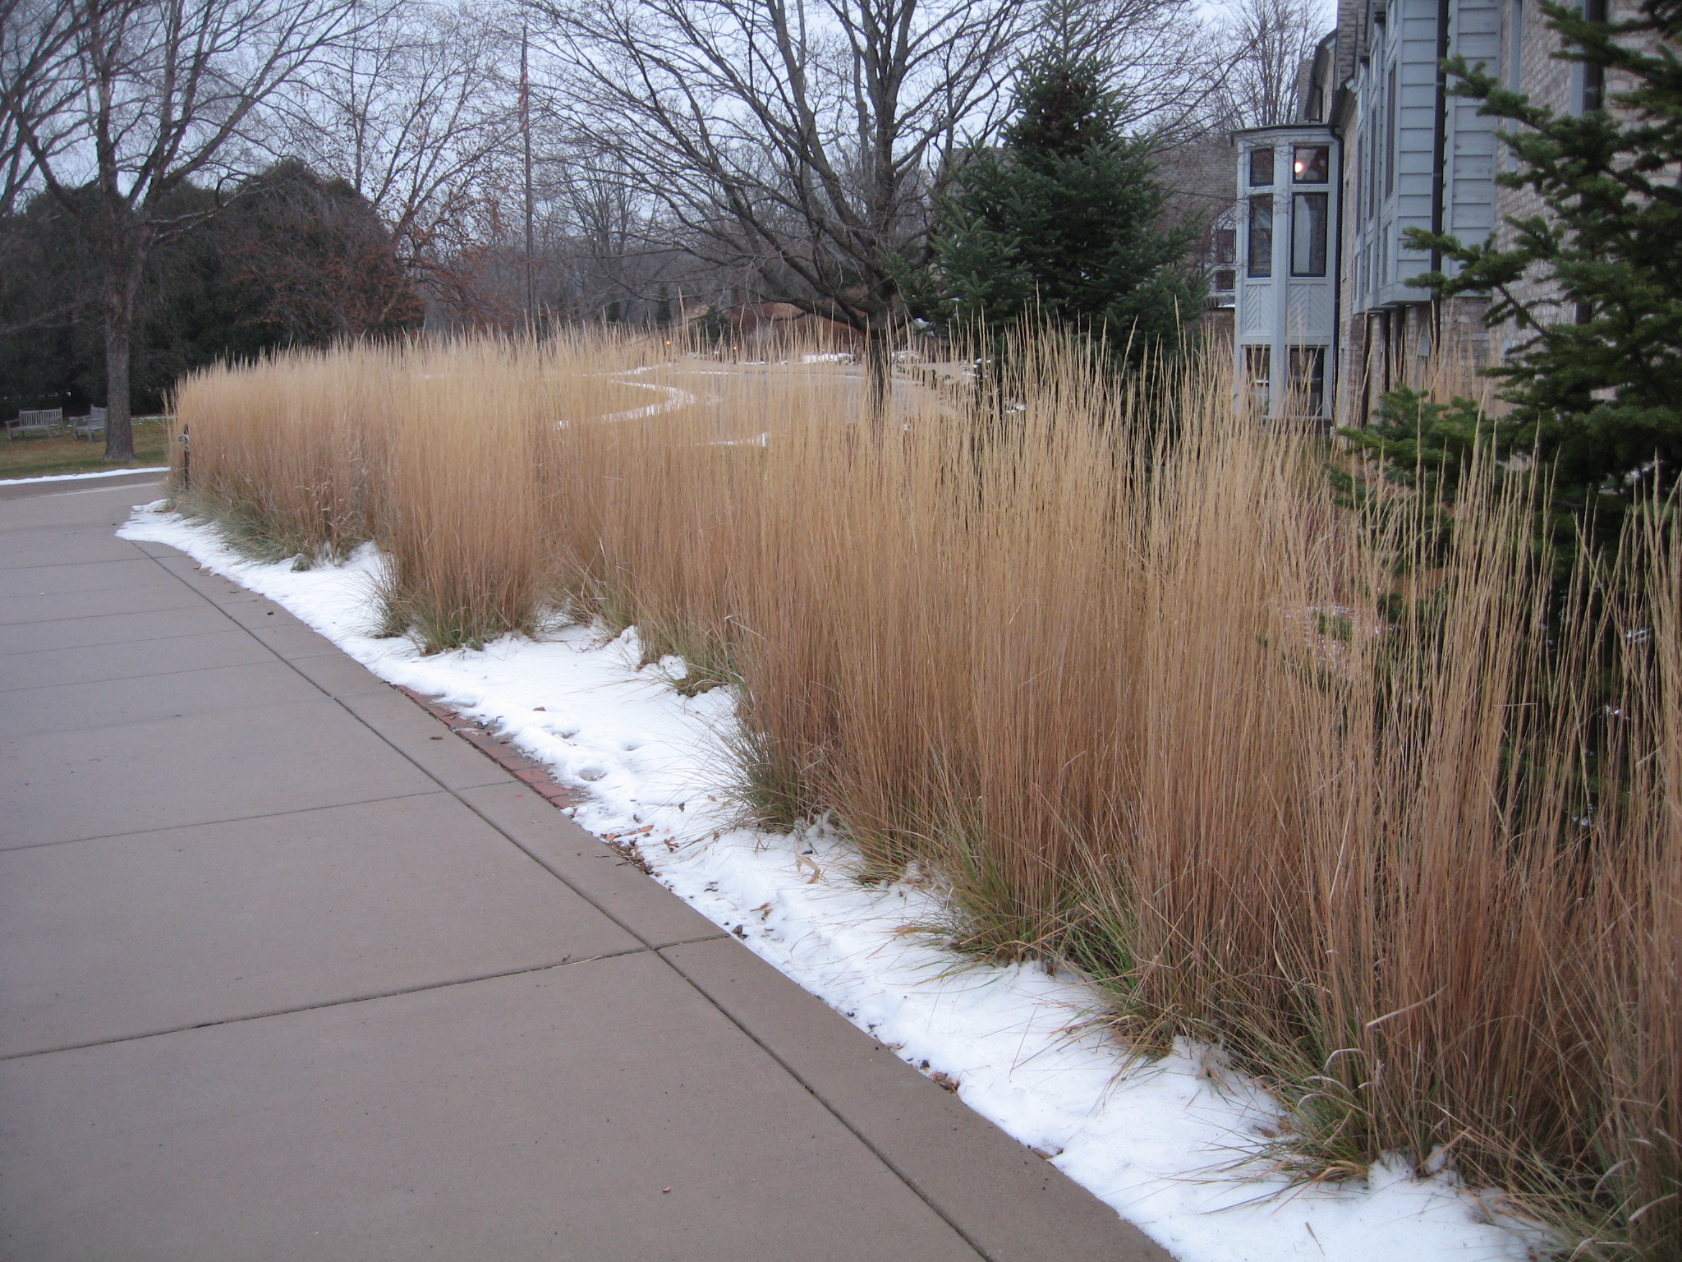
snow melts quickly of the road surface
snow melts slowly over the grass

Slide 13
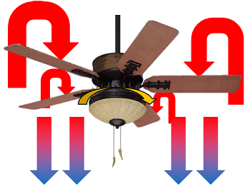
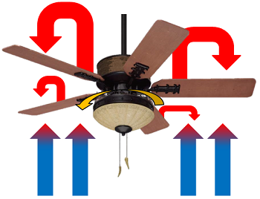
In the summer, ceiling fans rotate anticlockwise to mix warm air and force a cool breeze downwards, creating a downdraft.
In the winter, ceiling fans should rotate clockwise to draw cool air up from the room and force warm air downwards, creating an updraft.

Slide 14
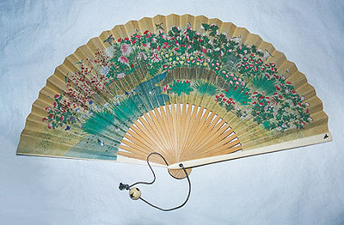

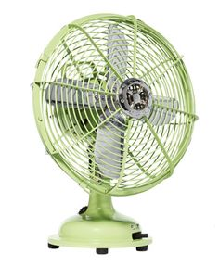
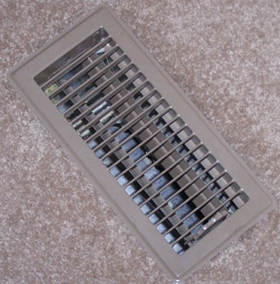
Why do people use a fan on a hot day ?
floor vent in air conditioning system to aid convection

Slide 15
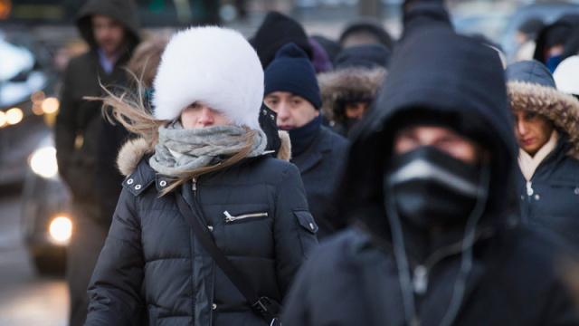
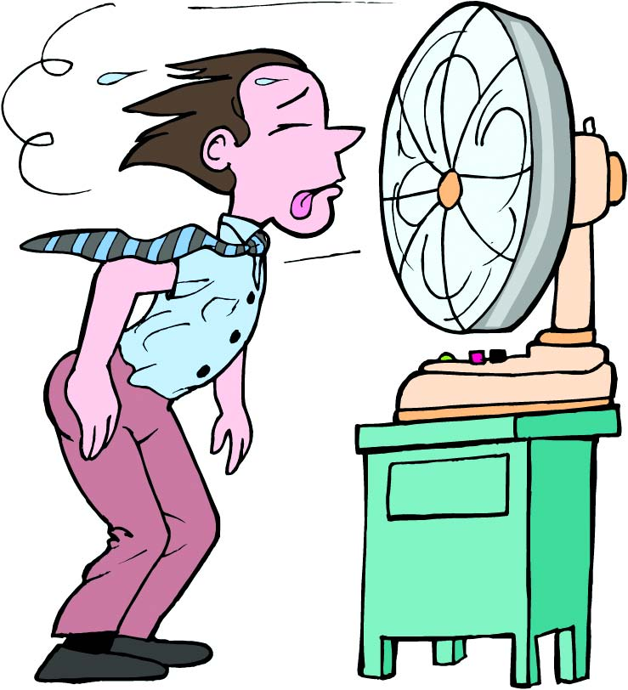
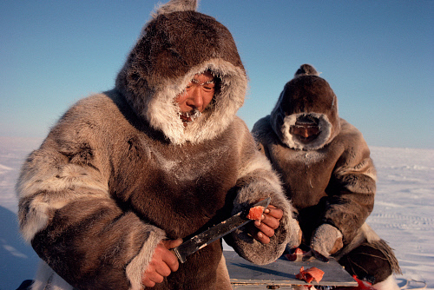
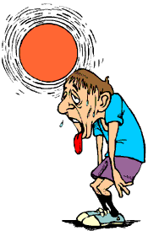
Why do people feel much colder on a windy day?
What is meant by the term wind chill factor?
Why does clothing keep us warm?

Slide 16
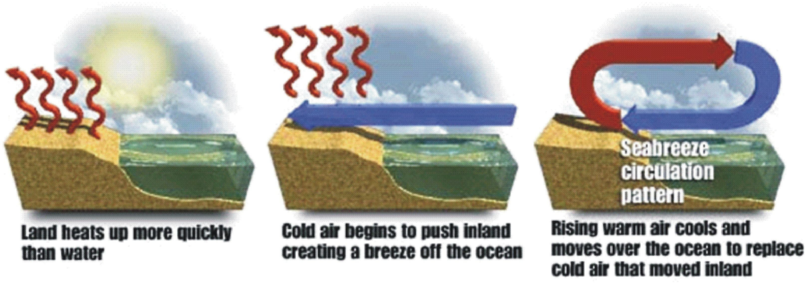
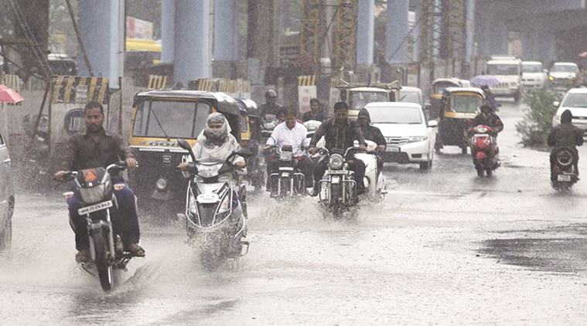
SEA BREEZE
During the day, land warms more quickly than water
Early afternoon cool air begins to push inland creating a breeze off the ocean
Late afternoon, rising warm air cools and moves over the ocean to replace cold air that moved inland
How is the monsoon season related to convection?

Slide 17

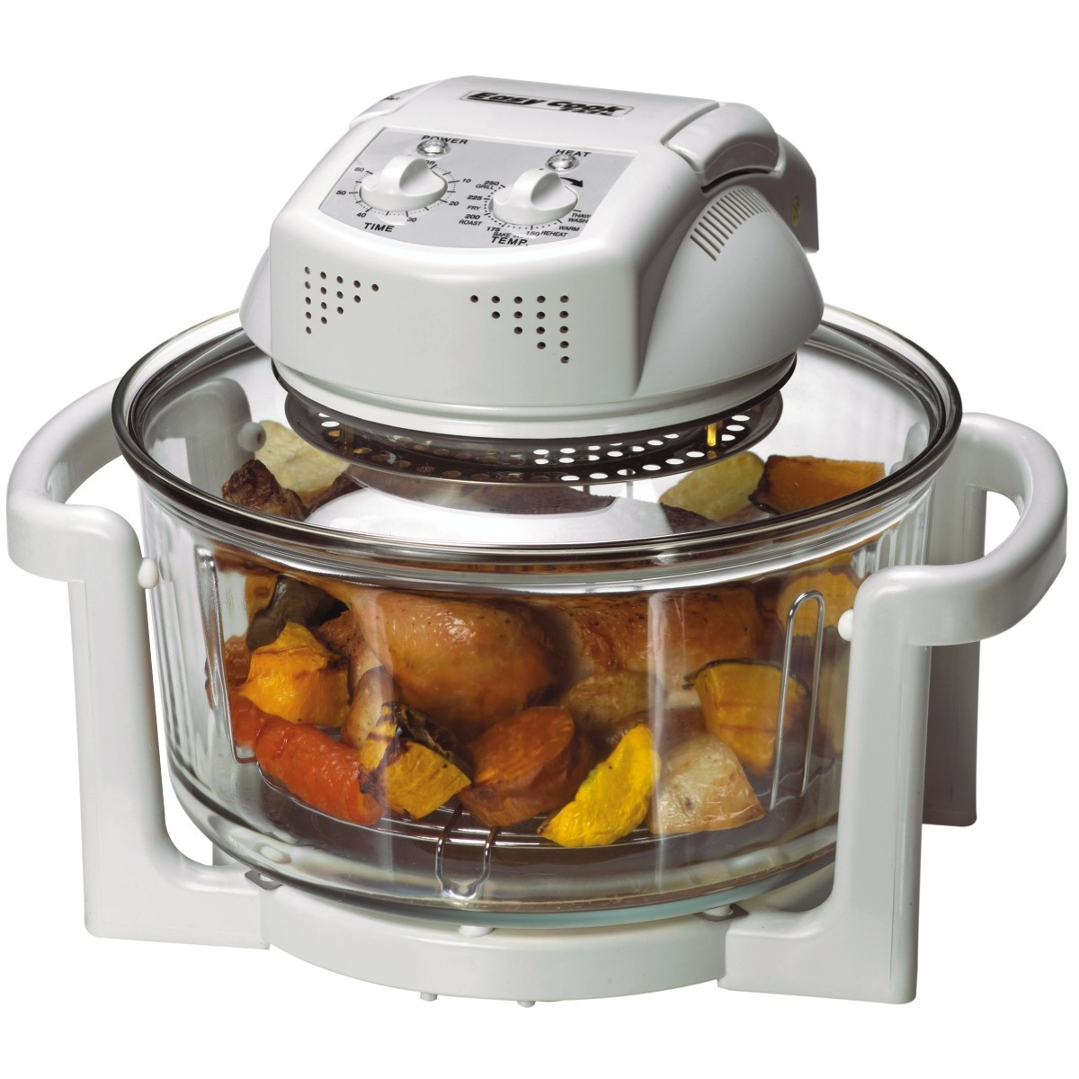
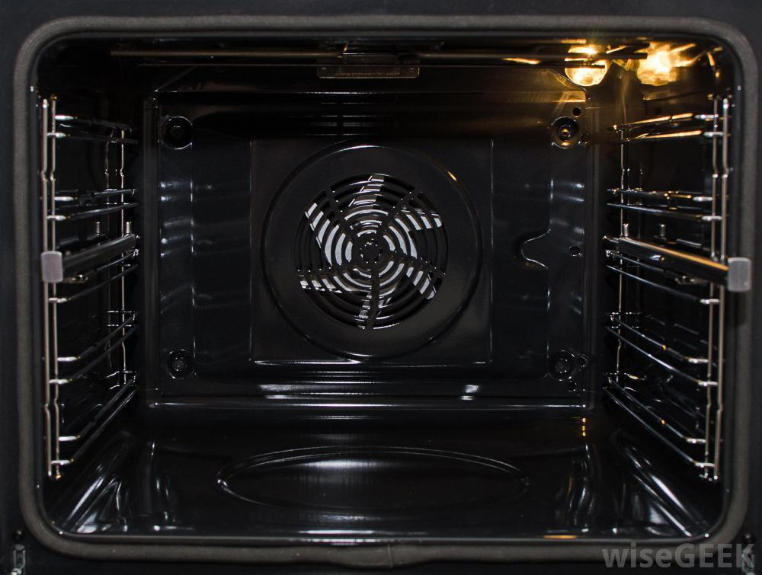
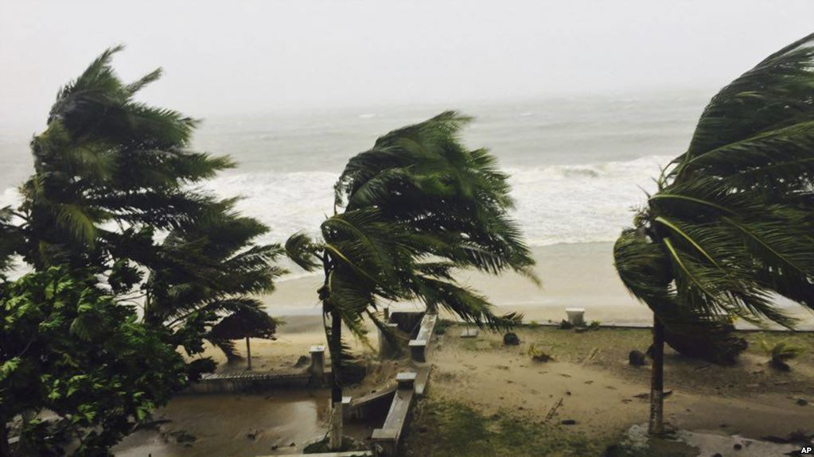
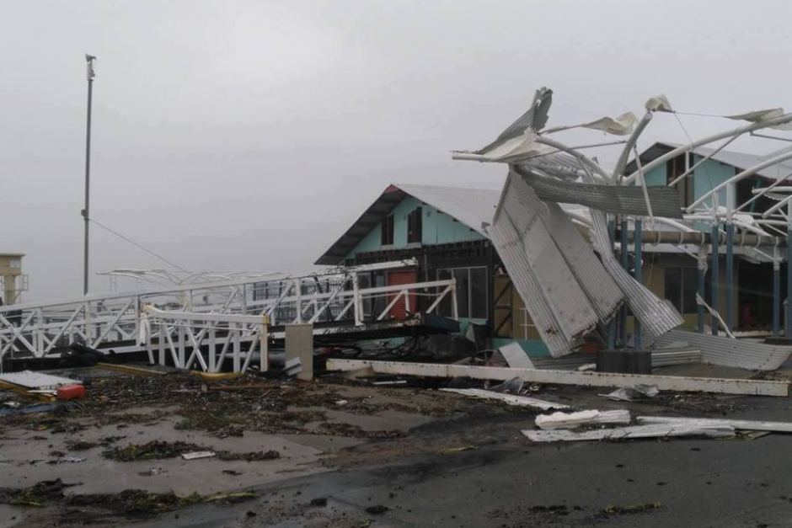
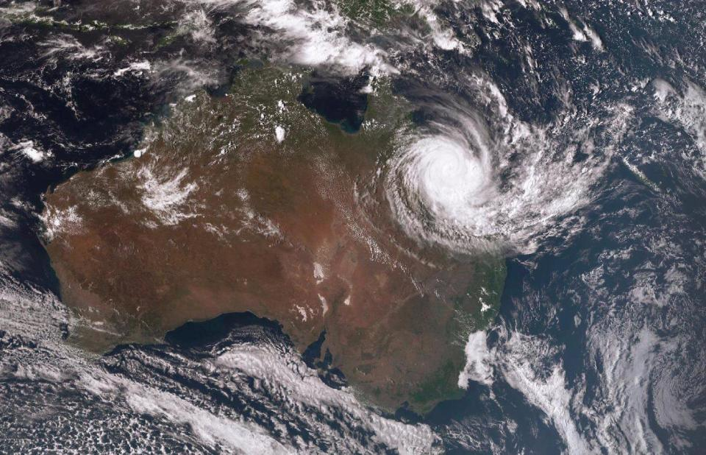

Slide 18
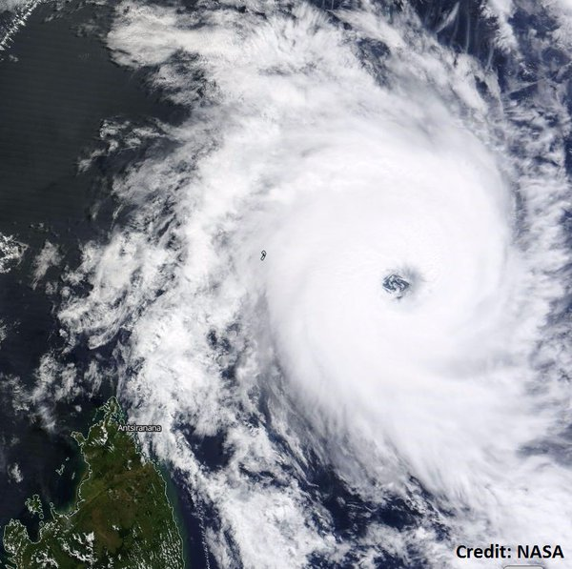



Slide 19
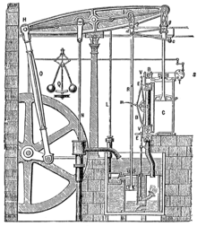
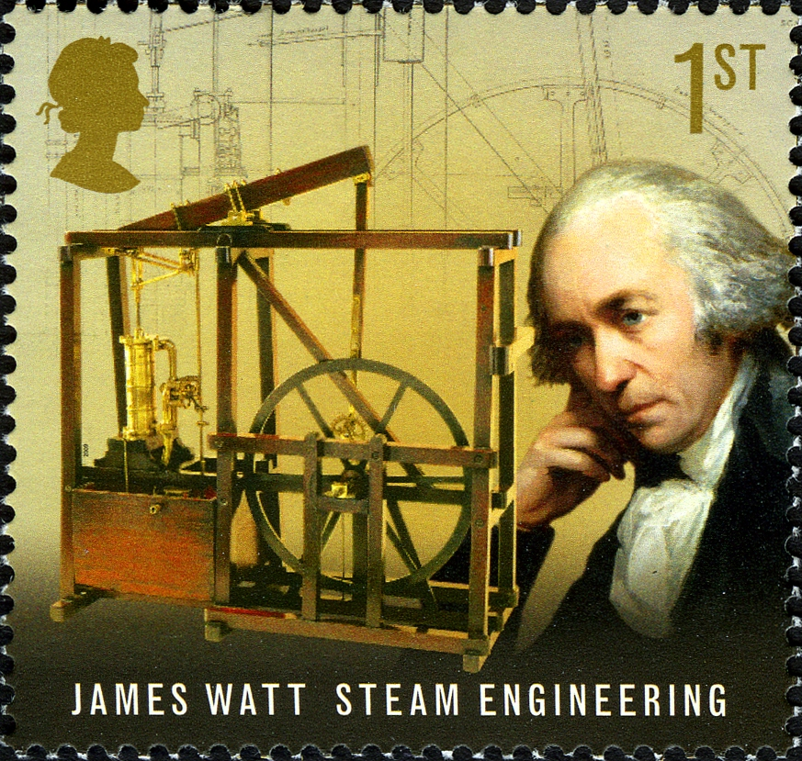

Slide 20
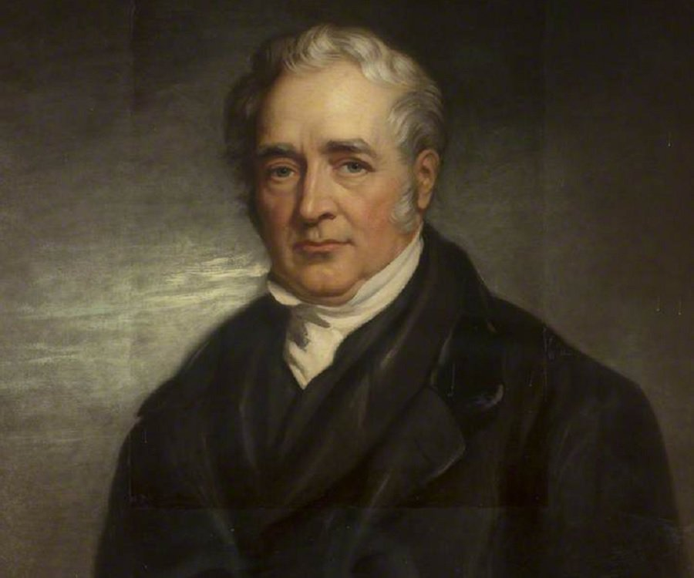
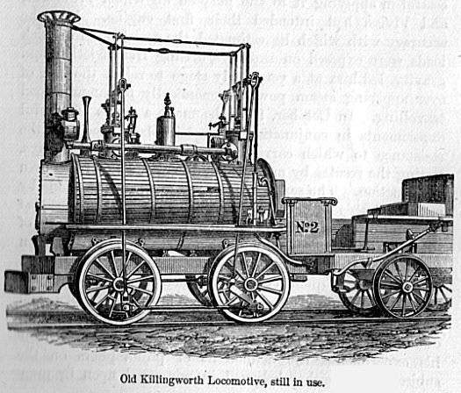
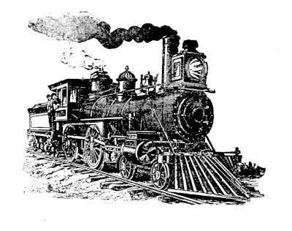
Locomotive constructed in 1816 by Stephenson for the Killingworth Colliery
steam train – mid 19th Century

Slide 21
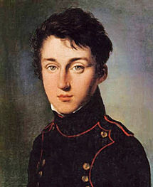
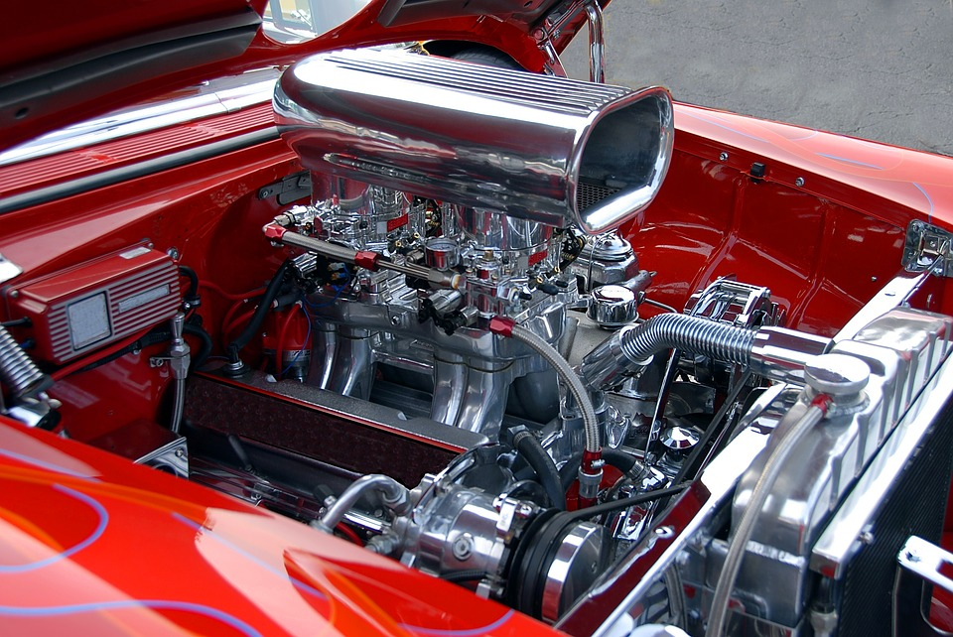
Nothing great is achieved without substantial effort. Only through efforts of physicists and engineers do we have the powerful and efficient car engine of today

Slide 22
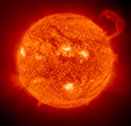
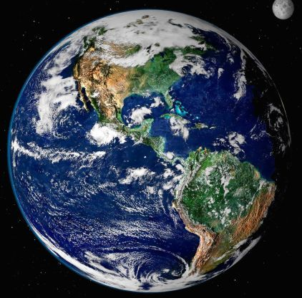
cold
hot
EMR
cold
The equatorial region receives a greater amount of energy from the Sun than the polar regions. The equatorial region does not get hotter and hotter because energy is transferred by convection through global atmospheric and ocean circulation currents.
Energy is transferred from hot to cold by convection

Slide 23
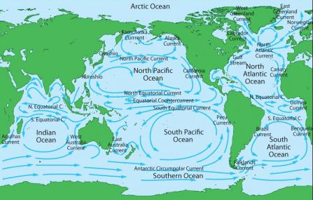
ocean currents
cold
hot
cold

Slide 24
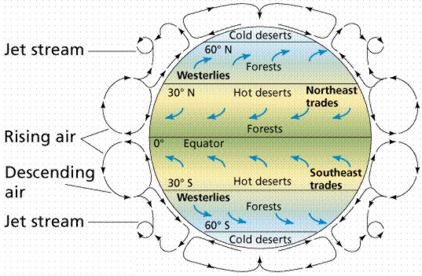
atmospheric currents

Slide 25
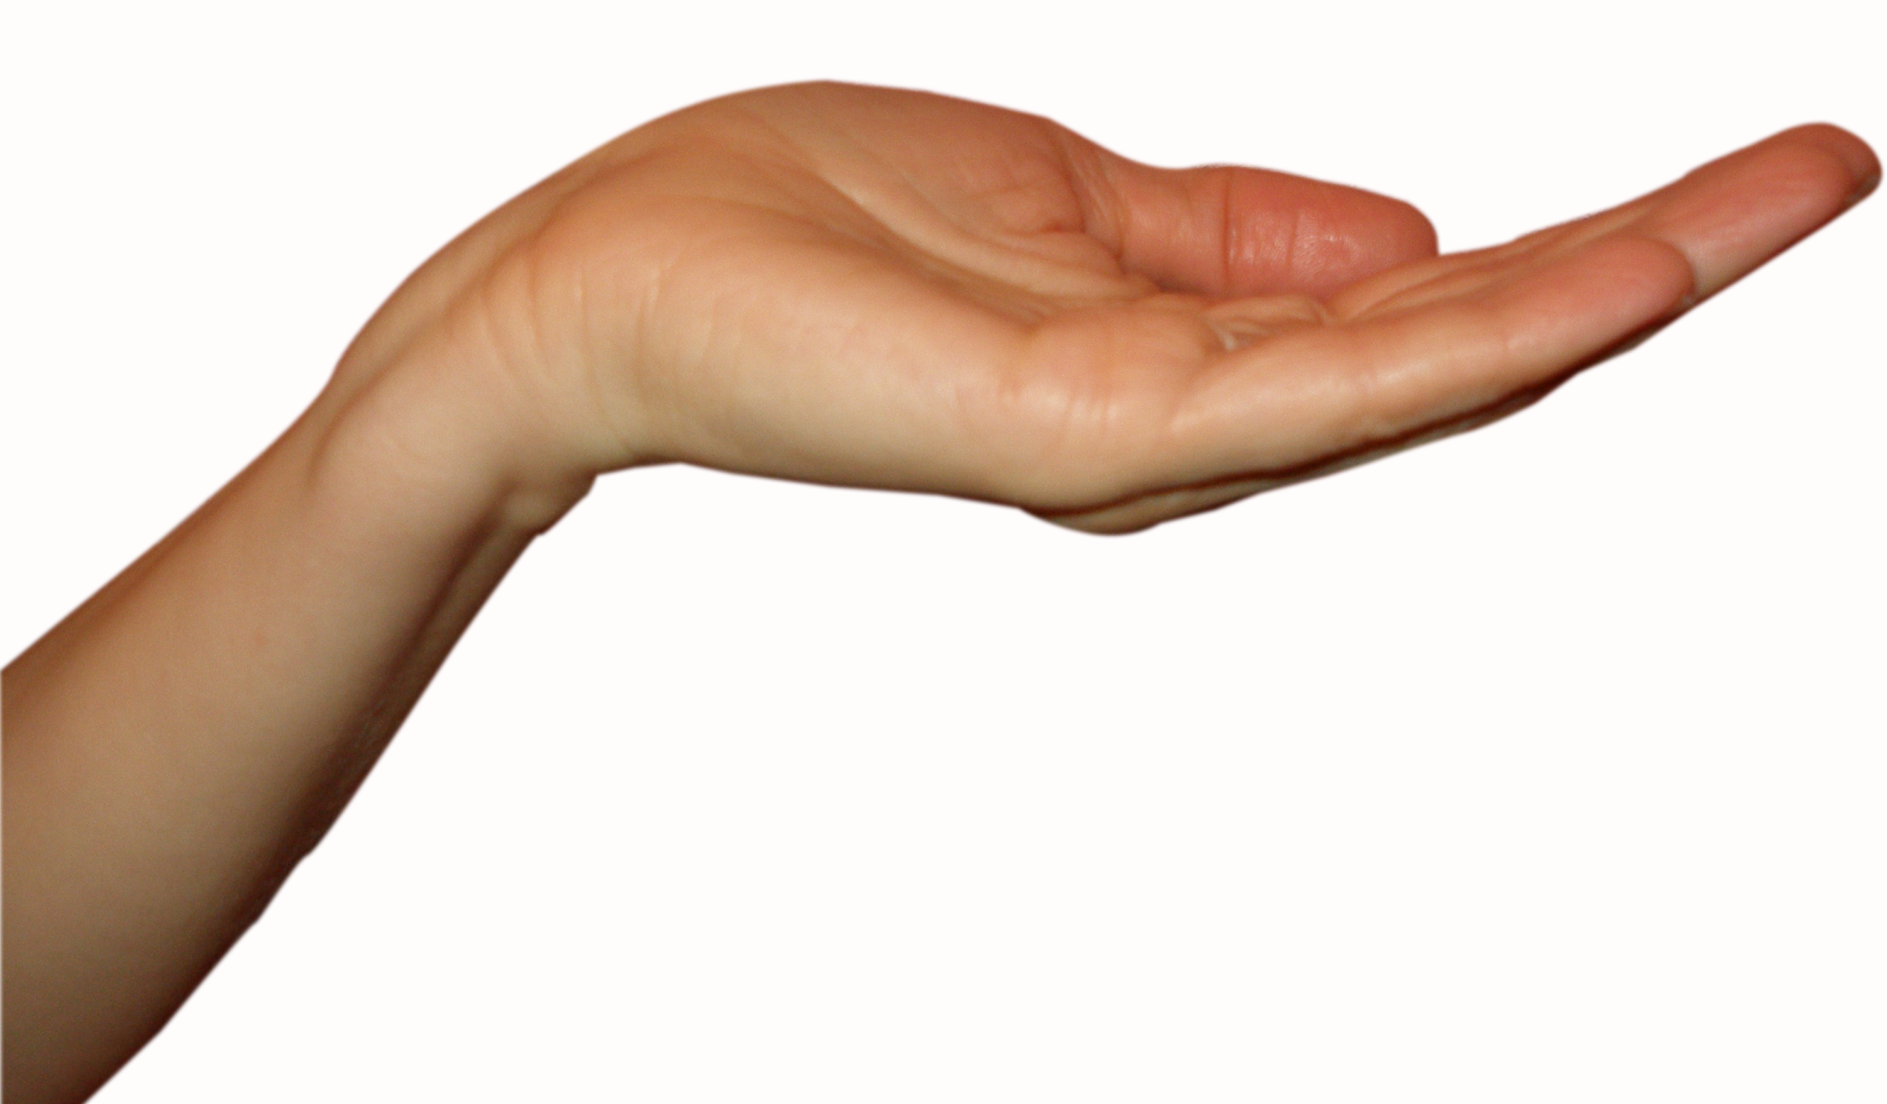
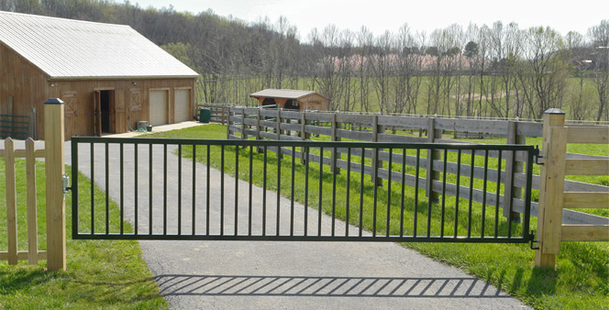
you say the wooden fence feels warm
MOREE N.S.W.
T = 41 ºC
you say the metal gate fence feels hot
If you measure the temperature of the metal gate and wooden fence with a thermometer, the two temperature will be the equal. You can’t judge temperature by touch, you need a thermometer. Touching a surface, your hands responds to the rate at which energy is transferred due to a temperature difference and not the temperature of the surface.

Slide 26
MARATHON MAN WHO MELTED
Meltdown Man Feb 1988
“It was just a fun run for a highly trained-trained athlete – until his temperature soared and the nightmare began” Woman’s Day Aug 14, 1990
EXTREME HEAT EXHAUSTION & DEHYDRATION
Core temperature 39 °C to 45 °C
Mark’s muscles literally liquefied (rhabdomyolysis – liquification muscle protein), blood thickened like molasses and failed to clot, kidneys failed, stomach collapsed, heart raced, lung problems, immune system failed - left leg amputated at hip (gangrene), coma (3 mths), mass 44 kg, could not walk, talk or roll over
31 operations

Slide 27
Body temperature
> 40.6 ºC ⇒ cell growth stops
> 42 ºC ⇒ irreversible chemical damage to the brain,
kidneys, and other vital organs
> 46 ºC ⇒ liquifications of proteins
T_{env} > 34 ºC ⇒ evaporation of perspiration only effective
mechanism for cooling the body
max rate of cooling ~ 650 W

Slide 28
THERMODYNAMIC SYSTEM
single or collection of objects
macroscopic & microscopic views
Environment
or Surroundings
System boundary
SYSTEM
Thermodynamic process: changes in p,V,T, U, S… by heat Q added or removed and/or work done W on or by the system
Quantity: mass m, moles n
# molecules, N
Dimensions: length L, area A, volume V
Pressure P
Temperature T
Internal Energy U
Entropy S
HEAT Q
WORK W

Slide 29
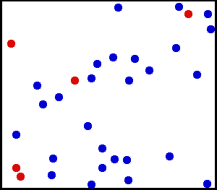
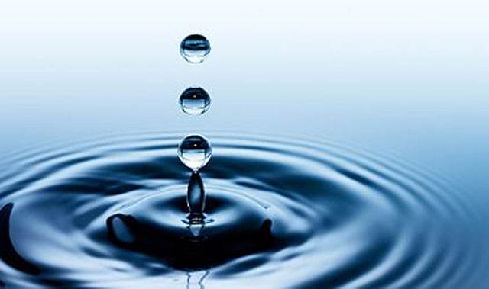
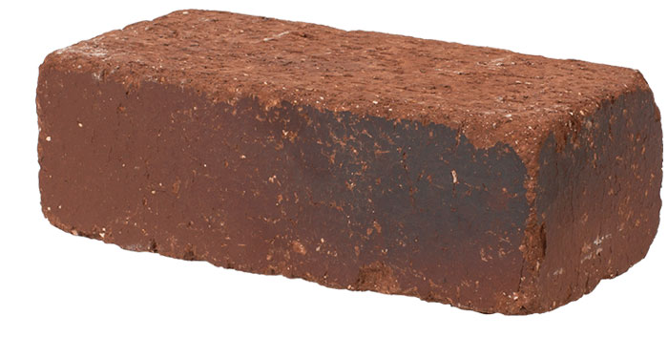
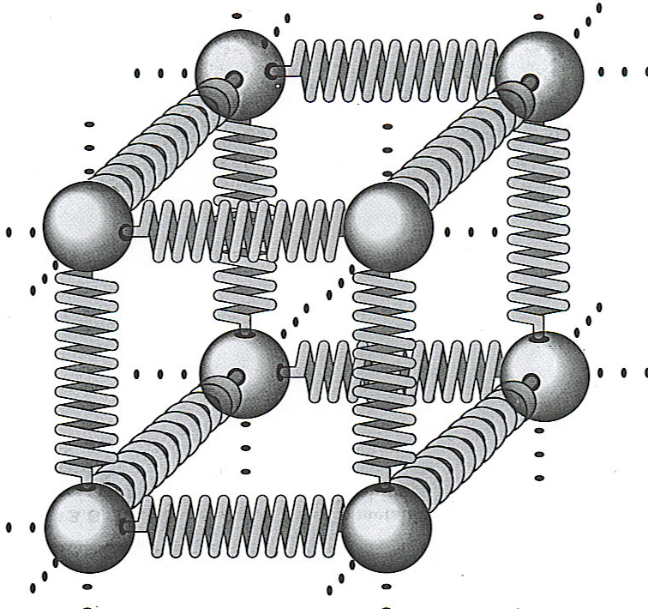
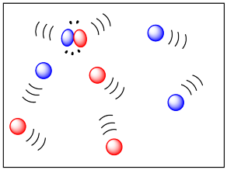
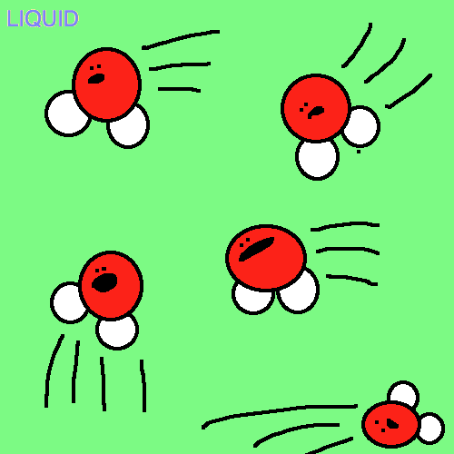
melt
boil
solid liquid gas
freeze
condense

Slide 30





Slide 31
translational K.E.
rotational K.E.
vibrational K.E.

Slide 32

 INTERNAL ENERGY U [ joule J ]
Value of U not important, ΔU during a thermal process is what matters
Random chaotic
motion
interaction
between atoms
& molecules
The system is the coffee.
The internal energy of the coffee decreases with time as energy is transferred from the hot System to the cooler surrounding environment.
Heat or heat transfer Q is the energy transferred to or from a System due to a difference in temperature between the System and its environment. The direction of the transfer is always from hot to cold.

Slide 33









Thermometers
Thermistor
Galilean
thermometer
Pyrometer
Thermocouple

Slide 34



Temporal artery thermometer – measuring infrared emission
Infrared scan

Slide 35

Constant volume gas thermometer
p = constant x T (T in K)

Slide 36

System: gas inside cylinder
translational kinetic energy of molecules increased ⇒ increase in temperature of System

Slide 37

You do work in rubbing your hands together – where does the energy go?

Slide 38

Temperature: Hot or Cold?
must be determined by a thermometer !

Slide 39
Absolute zero 0 K (-273.15 °C)
Helium boils 4 K (-269 °C)
Nitrogen boils 77 K (-196 °C)
Oxygen boils 90 K (-183 °C)
Dry ice (CO²) freezes 194 K (-79 °C)
Water freezes 273 K (0 °C)
Room temperature ~293 K (~20 °C)
Body temperature 310 K (~37 °C)
Water boils 373 K (100 °C)
Copper melts 1356 K (1083 °C)
Bunsen burner 2103 K (1870 °C)
Surface of the sun ~6000 K
Iron welding arc ~6020 K

Slide 40
System A
System B
thermal
contact

Slide 41
System A
System B
thermal
contact
Thermal Equilibrium

Slide 42
TEMPERATURE T – measure of the average random, chaotic translational motion of the particles of the system
Ideal Gas
E_{K_tr} total translation K.E. of molecules
E_{K_avg_tr} average K.E. of molecules
n moles ideal gas
R Universal Gas Constant
k Boltzmann Constant
T
T + ΔT
K_{tr} + ΔK_{tr}

Slide 43

Entropy – quantitative measure of disorder
spontaneous reaction as time elapses
organized effort requiring energy input

Slide 44
The arrow of time
perfume molecule

Slide 45

First Law of Thermodynamics
W
W > 0 work done by system
on surroundings
W < 0 work done on system
Q > 0 heat added to system
Q < 0 heat removed from
system
Q

Slide 46

the ice slows melts
water:
minimum order
maximum entropy
ice cube:
maximum order
minimum entropy
The water does not spontaneously freeze because this would lead to a decrease in entropy and a violation of the Second Law of Thermodynamics.

Slide 47
1000 particles moving randomly in a box
time = 0
Perfume released
How does it spread?
t = 20
t = 200
t = 400

Slide 48
high temperature
same temperature
low temperature
thermal equilibrium

Slide 49

heat: energy transferred due to the
temperature difference
work is done by the System
on the environment
system boundary

Slide 50


Slide 51
Identify / Setup
temperature T (K)
heat Q (J)
work W (J)
internal energy U (J)
thermal equilibrium
0th law 1st law 2nd law
T_{H}
Q
T_{C}
surroundings

Slide 52
2. Execute
(i) Temperature T – measure of hot/cold as determined by a temperature scale
T_{H}
Q
hot cold
T_{H}
>
T_{C}
Q
(ii) Heat Q energy transferred spontaneously due to a temperature difference (hot to cold) 2nd Law
T_{C}
(iii) Work W
Change in volume of coffee is negligible ⇒ W = 0

Slide 53
(iv) Internal Energy U
Random chaotic
motion
interaction
between atoms
& molecules
1st Law: Conservation of energy – transfer of energy by work W and heat Q between thermodynamic system and surrounding environment gives a change in internal energy ΔU = Q – W
Heat is transferred to surroundings from the coffee, giving a decrease in the coffee’s internal energy: W = 0, Q < 0 ⇒ ΔU < 0 (decrease in temperature)
(v) The temperature of the coffee decreases until it is in thermal equilibrium with the surroundings
T_{coffee} = T_{surroundings} 0th Law

Slide 54
hot cold

Slide 56



conduction though glass
Q
$$T_{c}$$
Q
$$T_{H}$$

Slide 57



Slide 58



Heat engine: device that transforms heat partly into work (mechanical energy) by a working substance undergoing a cyclic process.

Slide 59
Hot Reservoir
energy from burning petrol
Q_{H}
W
Engine
Surroundings
Q_{C}= 0
energy in moving the car
A heat engine can never be 100% efficient in converting heat into mechanical work ?
Why does this engine violate the Second Law, because?

Slide 60
Hot reservoir
energy from burning petrol
Q_{H}
energy in moving the car
W
Engine
Surroundings
Q_{C}
heat transferred to surroundings: this energy can’t be utilized
Cold reservoir
A working engine since Second law of thermodynamics is satisfied

Slide 61


heat Q is the energy transfer due to a temperature difference ΔT
CONDUCTION
CONVECTION
RADIATION
Q_{net}
system T
Environment T_{ENV}
European heat wave, 2003 ⇒ ~35 000 deaths in France

Slide 62




Live sheep trade
Sunday, October 26, 2003
Sheep to shore ... finally
The Labor Opposition will pursue the Government over the cost of the "ship of death" saga, which ended on Friday when 50,000 Australian sheep at sea for three months began being unloading in Eritrea.

Slide 63





Slide 64



Slide 65

Q_{rad}
A, e, T

Slide 66


Slide 67


Slide 68

heater

Slide 69



Slide 70
T_{H}
T_{C}
Q
A
energy transferred through slab in the time interval Δt is ΔQ
k
d

Slide 71
-40 ºC
k_{ice} = 1.67 W.m⁻¹.K⁻¹
6.5 ºC
thickness Δx = 0.30 m
ΔT = 46.5 ºC
radius R = 2.55 m
surface area of hemisphere

Slide 72

Q
T_{H}
T_{C} = 8 ºC
air or water
System: person
k_{air} = 0.024 W.m⁻¹.K⁻¹ k_{water} = 0.6 W.m⁻¹.K⁻¹

Slide 73




Slide 74


paper strip
copper
wood
burn mark
centre of paper
burn mark
more towards
wood
burn mark
more towards
copper

Slide 75


Why is the figure on the right not as good as the figure on the left?
direction of heat transfer

Slide 76
100 ºC
100 ºC
steel
copper
steel
copper
0 ºC
0 ºC

Slide 77




lightning
neon sign
lightning
ball
gas discharge tubes

Slide 78

2

Slide 79

Hey, today, we’re gonna see strange properties of convection currents
You be the warm particle, you be the cool one
Warm? UP
Cool ?
DOWN
COOL!
Help, I hate floating
I have a sinking feeling
Oops!

Slide 80

mass of material m
specific heat c

Slide 81





Slide 82
 Phase changes
at constant temperature
Q= ± m L_{S}
deposition
L_{S} latent heat of sublimation
or heat of sublimation
sublimation
freezing
condensation
solid
liquid
gas
melting
evaporation
Q= ± m L_{f}
Q= ± m L_{V}
At melting point: L_{f} latent heat of fusion or heat of fusion
At boiling point: L_{V} latent heat of vaporization or heat of vaporization
Q > 0 energy absorbed by substance during phase change
Q < 0 energy released by substance during phase change

Slide 83


Phases of matter
Gas - very weak
intermolecular forces,
rapid random motion
high temp
low pressure
Liquid - intermolecular
forces bind closest neighbours
low temp
high pressure
Solid - strong
intermolecular forces

Slide 84
Heating 1.0 kg ice to steam (-20 ºC to 120 ºC)
P = 2000 W | Time t (min) | Heat Q (kJ) | Time Ratios
Ice: -20 ºC to 0 ºC | 0.37 | 44 | 1.0 (0.37/0.37)
Ice / Water: 0 ºC | 2.78 | 333 | 7.5 (2.78/0.37)
Water: 0 ºC to 20 ºC | 0.70 | 84 | 1.9
Water: 0 ºC to 100 ºC | 3.49 | 419 | 9.4
Water / Steam: 100 ºC | 18.80 | 2256 | 50.8
Steam: 100 ºC to 120 ºC | 0.34 | 40 | 0.9

Slide 85
Simple model for heating a substance at a constant rate
T(t)
boiling
point
g
l /g
melting
point
l
s / l
s
Q(t)
mc_{s}ΔT
mL_{f}
mc_{l}ΔT
mL_{v}
mc_{g}ΔT

Slide 86




Slide 87


Slide 88
r
h

Slide 89

The human body has an internal physiological self-cooling mechanism. the brain instructs the body to sweat to keep cooler.

Slide 90



Slide 91


Slide 92

close the window you’re letting in the cold
Thermodynamics:
The heat goes out

